Slide 1

Innovation Lab Project
(Data Visualization)
Guided by: Prof. Sourav Dandapat

Slide 2

Problem Statement
To create a framework for the collection of covid data of India and putting them into a database. Use different visualisation tools to visualize time series data pattern.

Slide 3
Flowchart of work
Data Collection
Upload data into a database
Connection of database to jupyter notebook
Graphical analysis of data

Slide 4

Tools used in the project
MySQL as DBMS
Jupyter Notebook as platform to run program
Matplotlib to visualize data time series pattern using Python as language
Pre-built Python libraries like Numpy, Pandas, Seaborn etc.

Slide 5

Data collection
Data of Covid-19 cases of India is collected.
Data is collected on the state level and national level.
Data includes the daily confirmed cases, daily recovered cases, and daily deceased cases , due to Covid-19, of each state and union territories as well.
Data includes the collection of daily cases of Covid-19 from 14th March 2020 to 10th October 2021.
Data preprocessing and cleaning is done.

Slide 6
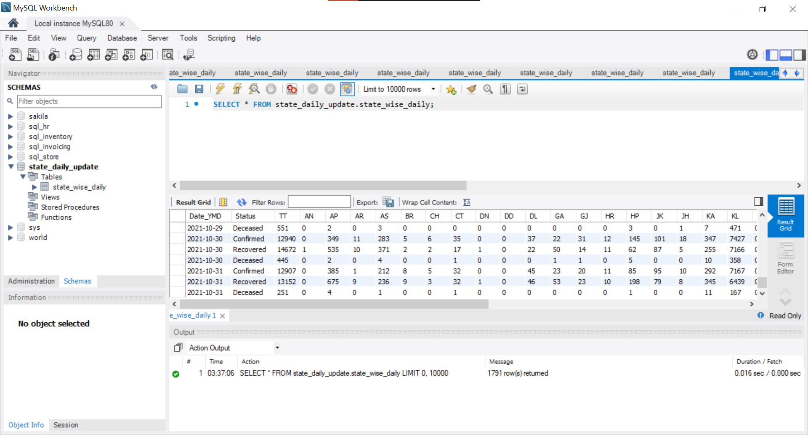
Data uploaded on database
MySQL is used as database management system.
Database: “state_daily_update”
Table: “state_wise_daily”

Slide 7
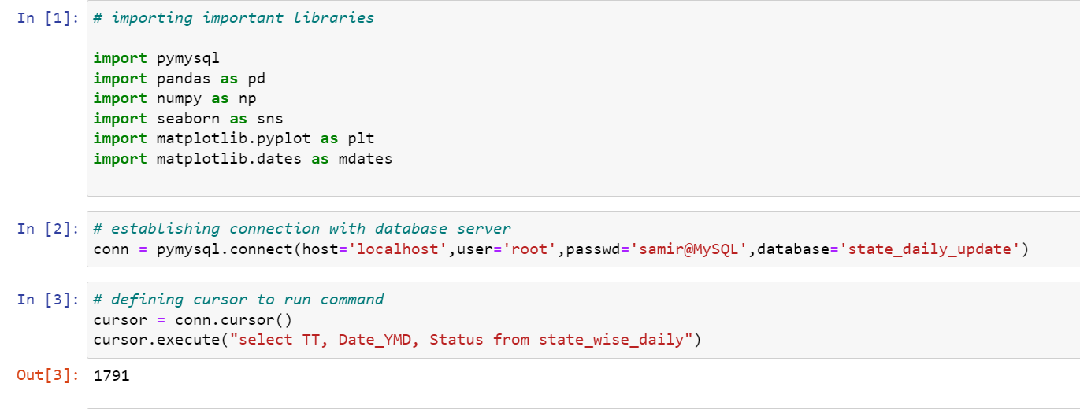
Connection of database to jupyter notebook
Establishing connection of jupyter notebook with MySQL database management system to fetch required data and importing used python libraries:

Slide 8
Introduction to data visualization
What is Data Visualization?
Data visualization is the graphical representation of information and data. By using visual elements like charts, graphs, and maps, data visualization tools provide an accessible way to see and understand trends, outliers, and patterns in data.

Slide 9
Line Graph
Bar Graph
Scatter Plot
Subplots
Pie Chart
Histogram
Distplot
Joint plot
Strip plot
Pair Plot
Swarm Plot
Graph used in the project to visualize data

Slide 10
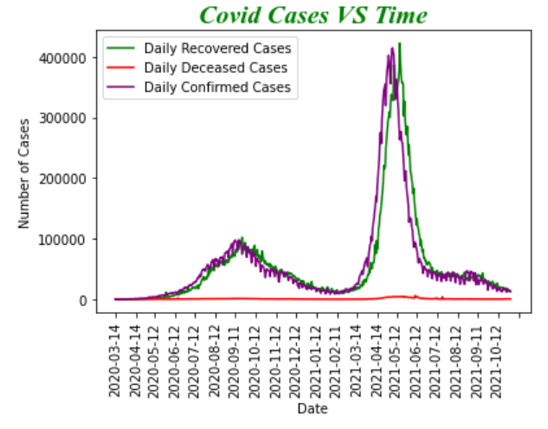
Graphs plotted in the project:
Line Graph
It is the line graph representing number of confirmed cases, recovered cases, and deceased cases on the same axis for better visualization.

Slide 11
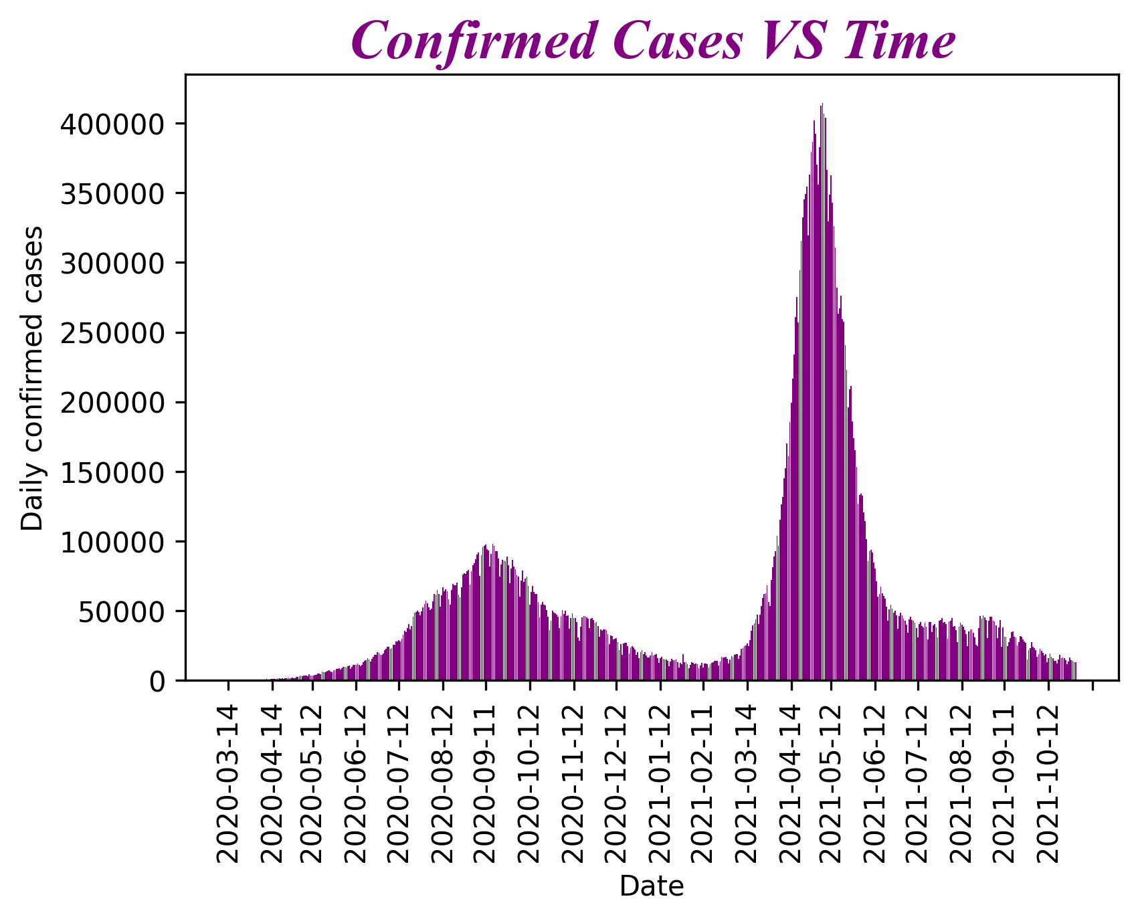
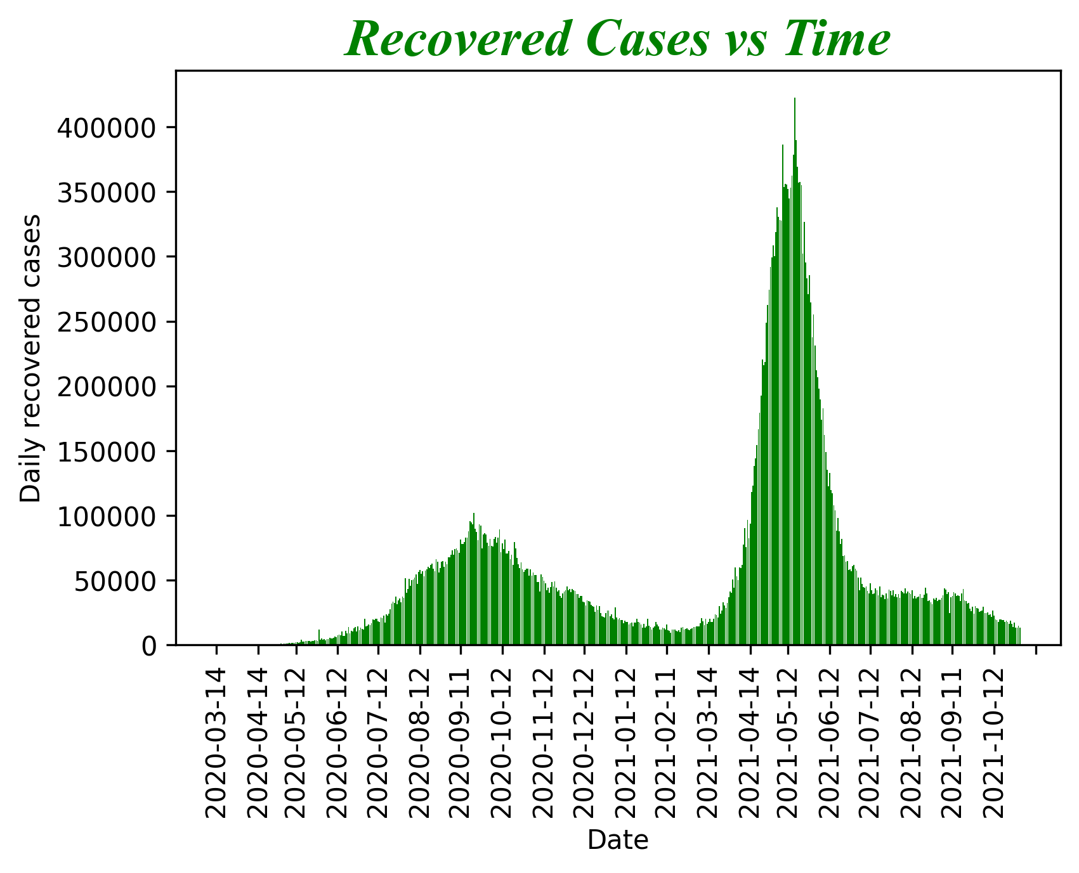
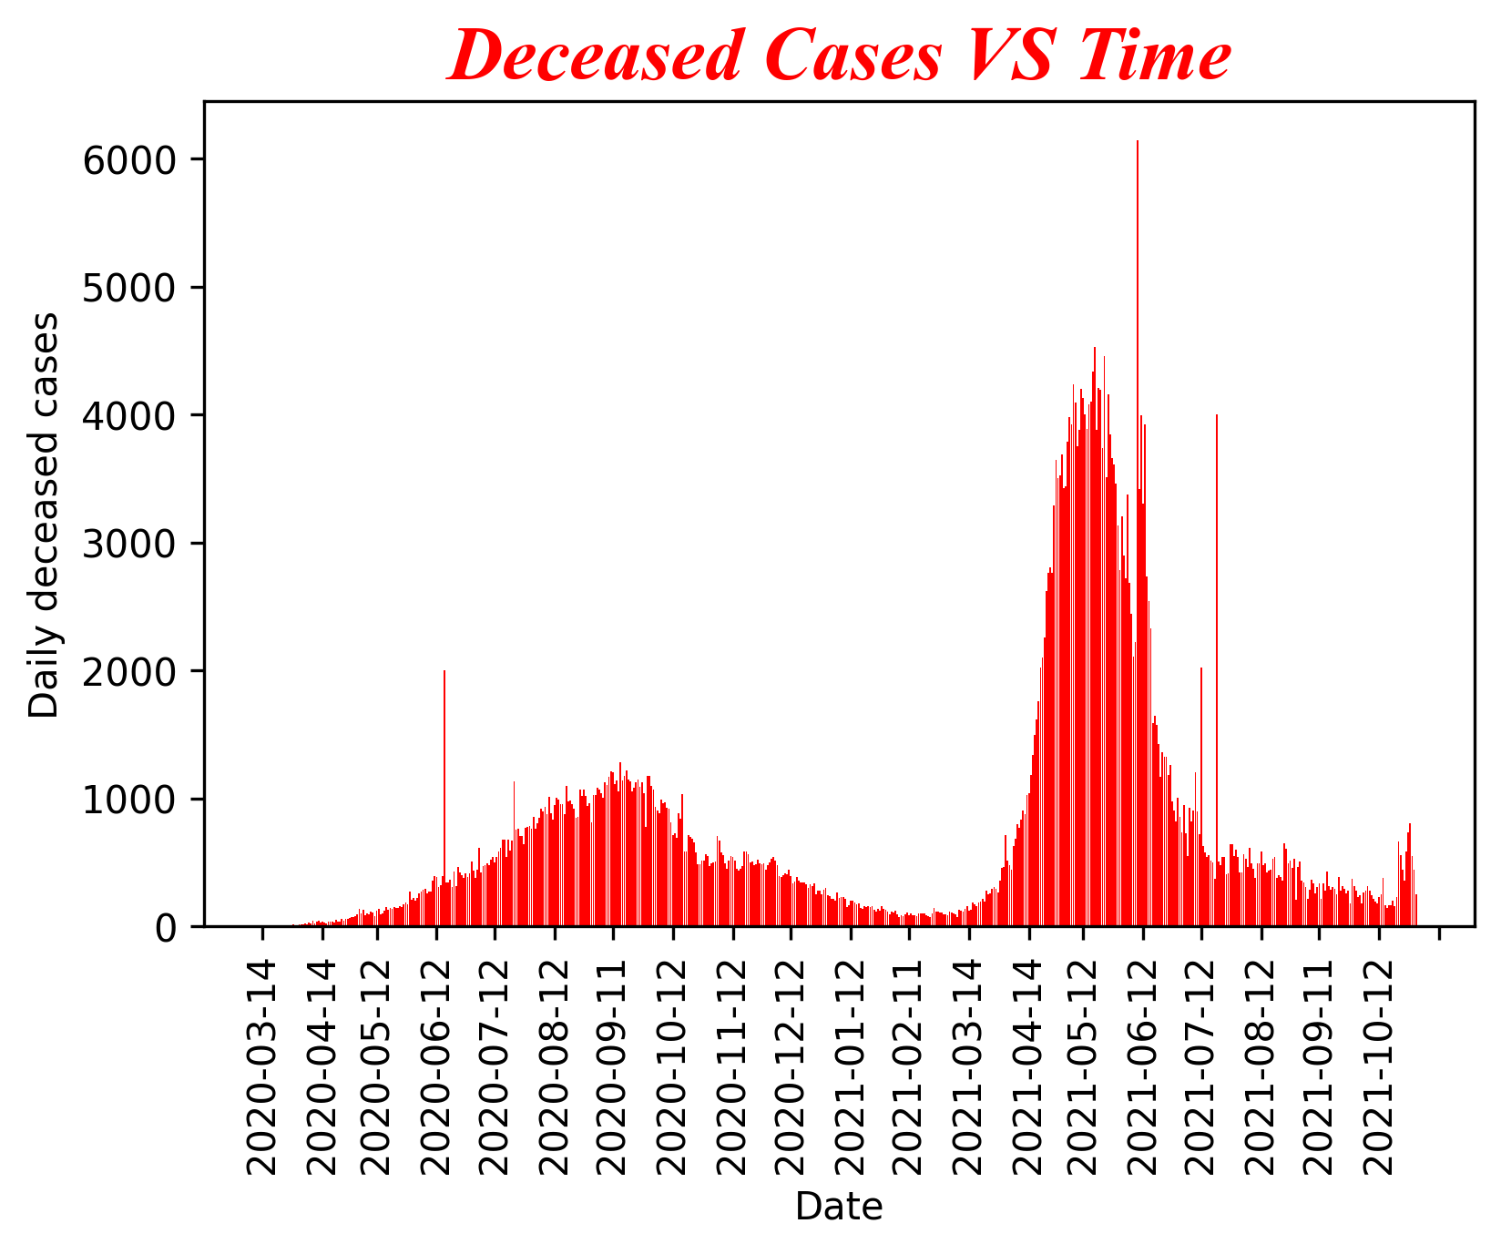
Bar Graph
Bar graph is representing confirmed, recovered and deceased cases in India on daily basis.

Slide 12
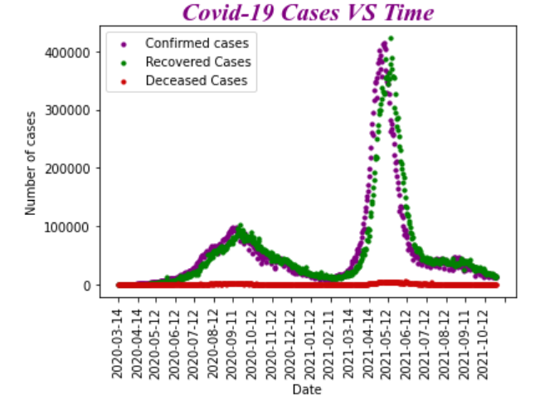
Scatter plot
It is a scatter plot representing number of case in India against time. Legend is shown in graph. Two waves of corona is clearly seen here.

Slide 13
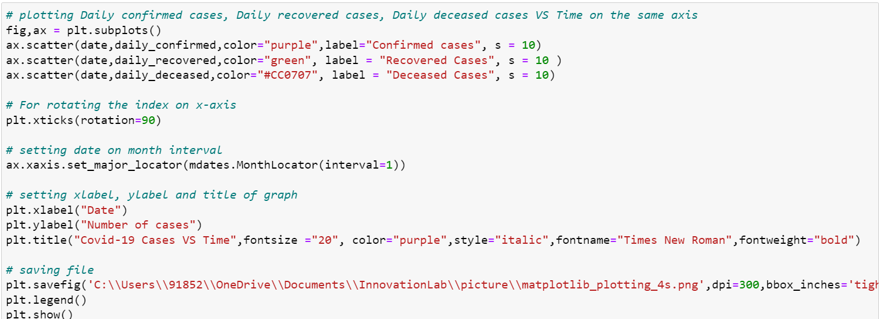
Code of the Scatter plot:

Slide 14
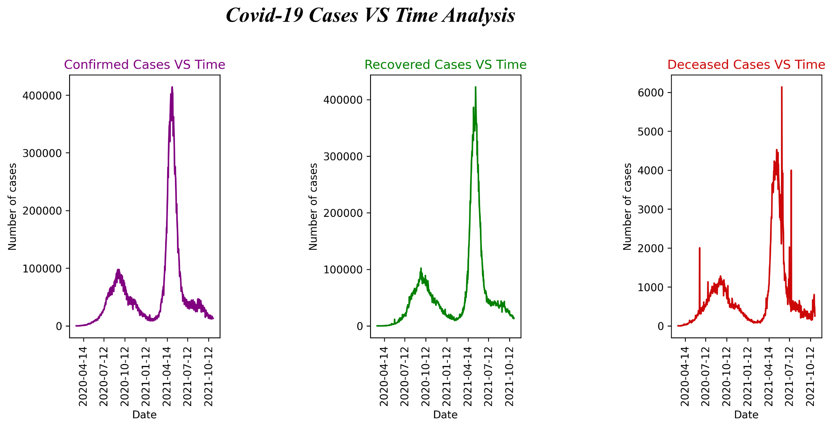
Plotting of bar graph using subplots
It is subplots used in the graph. In this, x-axis is divided into three parts to represent different graphs.

Slide 15
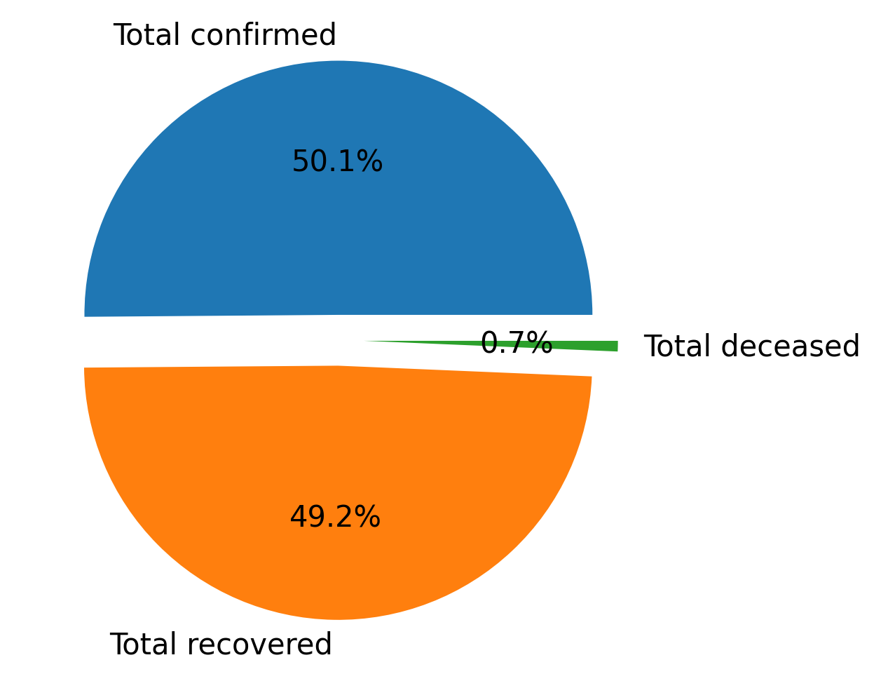
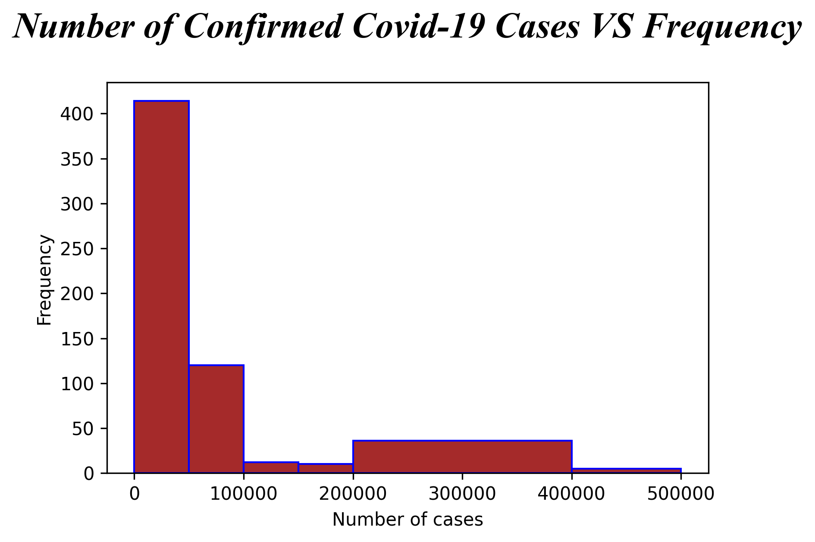
Pie chart
Histogram

Slide 16
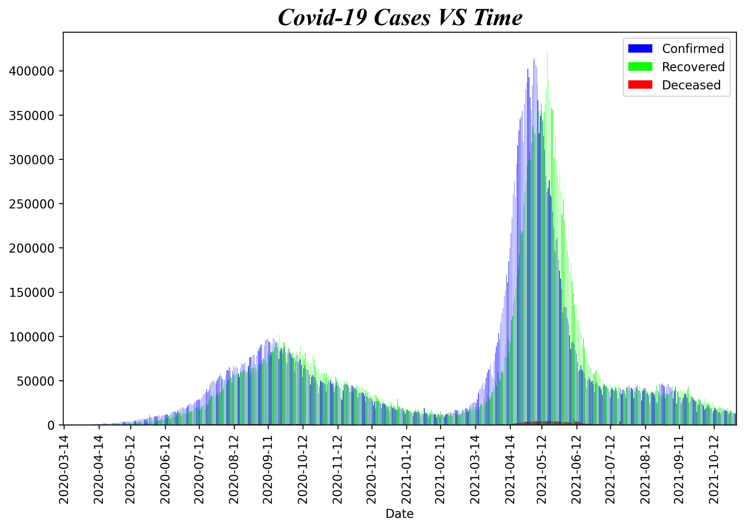
Bar Graph with number of daily confirmed cases, daily recovered cases, and daily deceased cases against time.

Slide 17
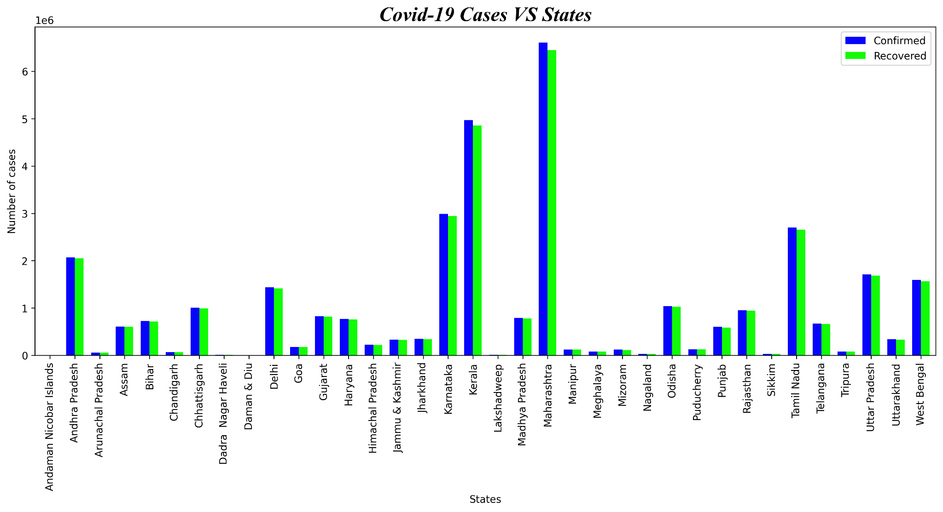
Distribution of Covid case among various state till the end of 2nd wave
Analysis:
Maharashtra is the most affected state followed by Kerala, Karnataka, Tamil Nadu, Andhra Pradesh.

Slide 18
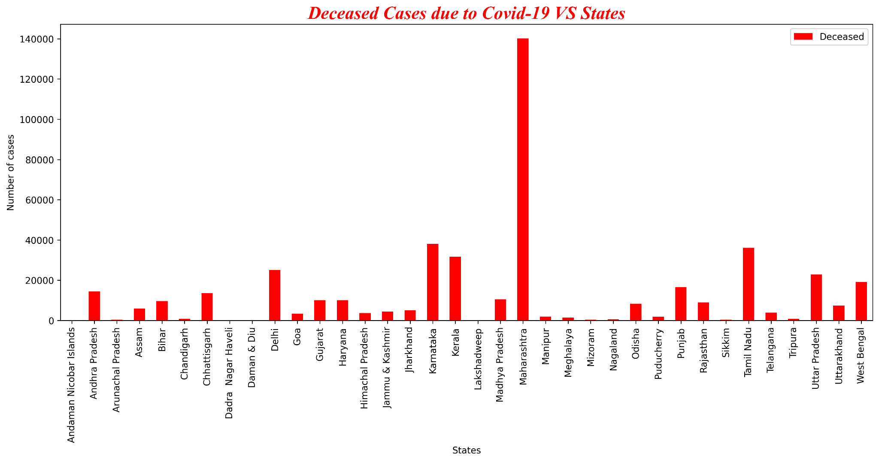
Distribution of number of deaths in various states
Analysis:
Maharashtra is most affected states due to Covid-19,

Slide 19
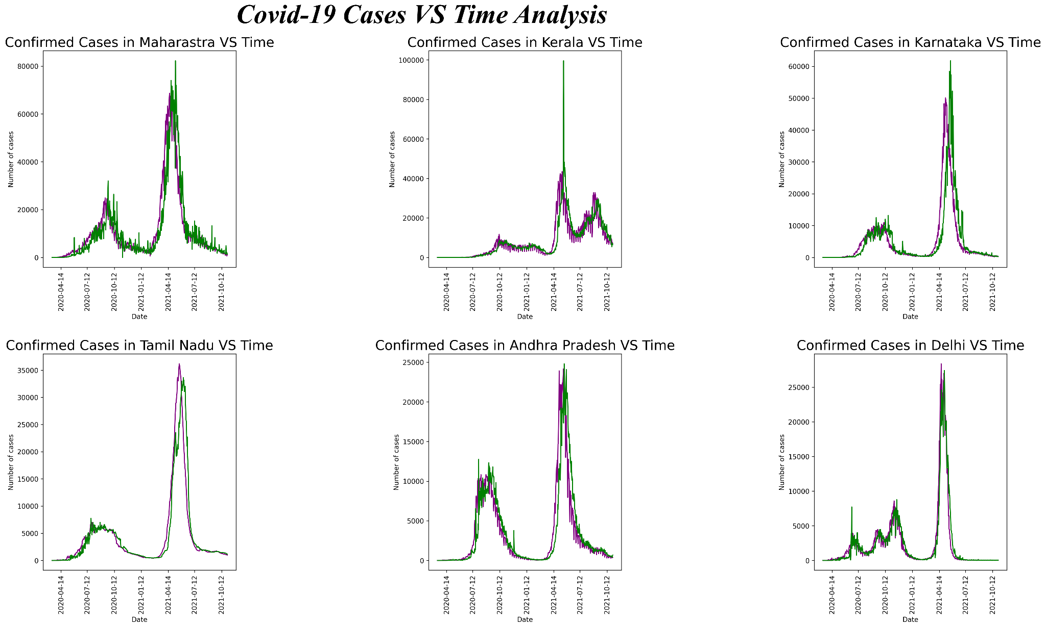
Comparative analysis of Covid-19 cases in six most affected states

Slide 20
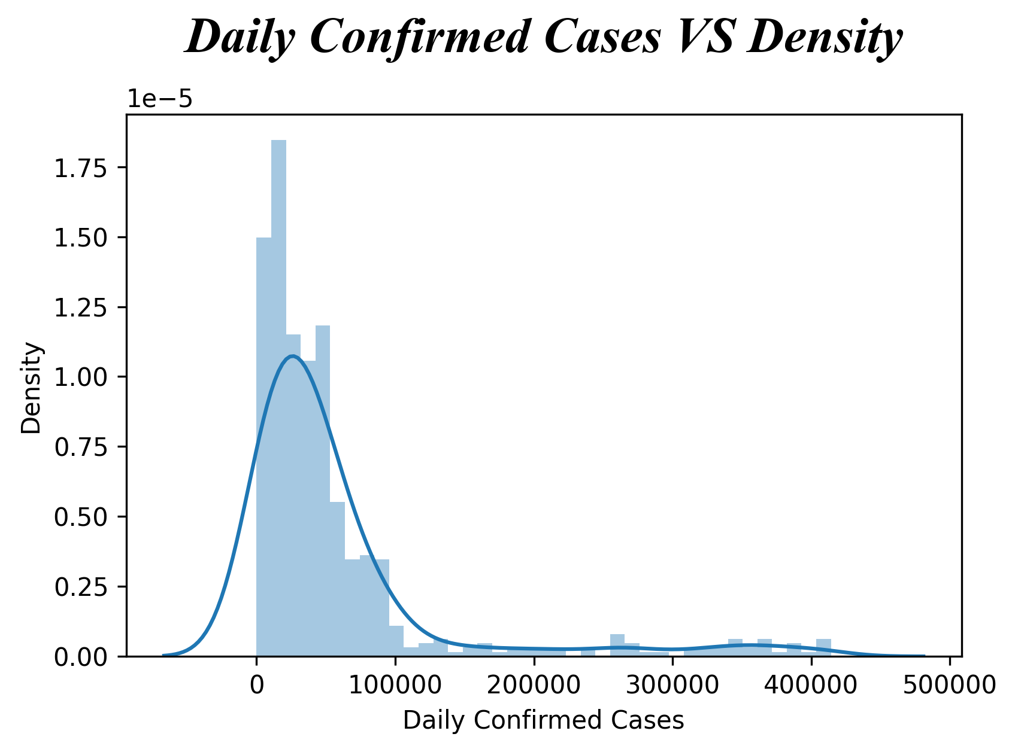
Distplot
It represents the frequency of occurrence of cases in specific range.

Slide 21
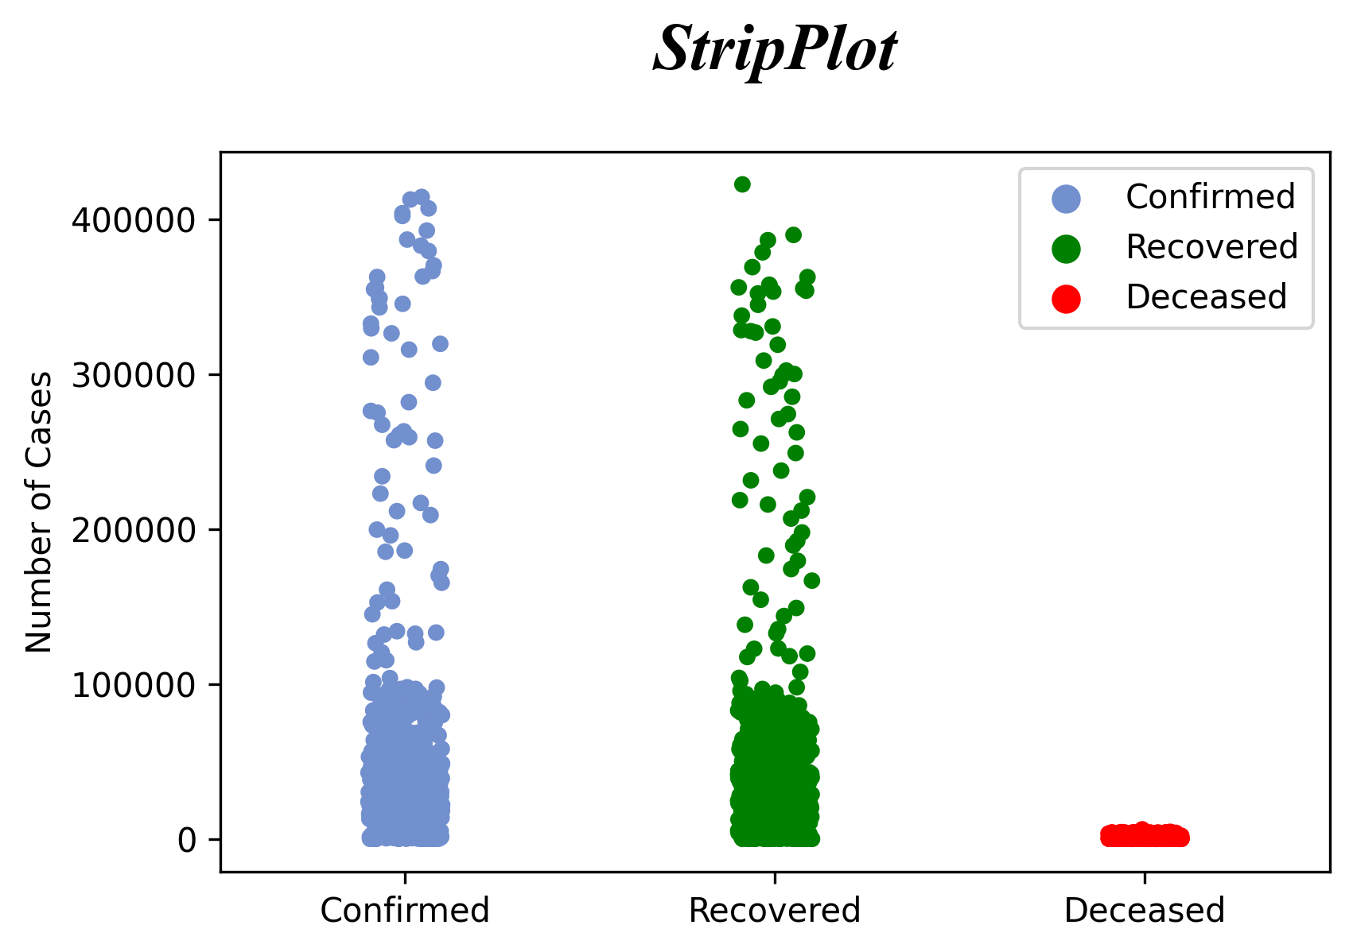
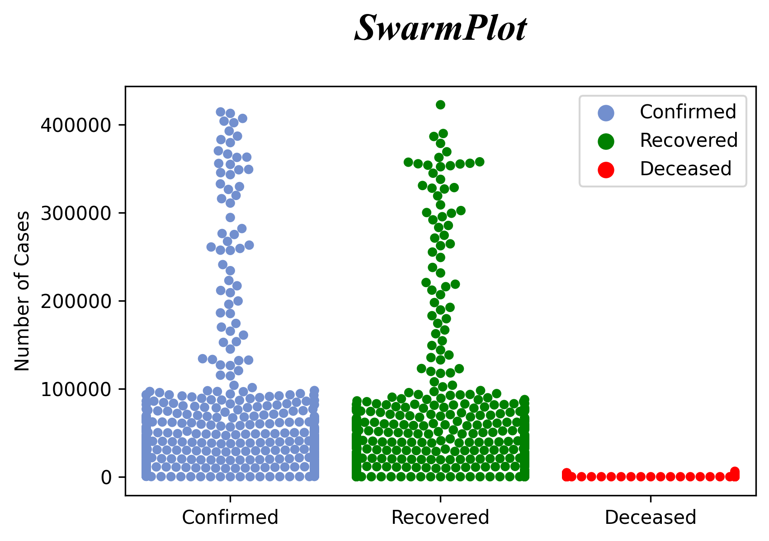
Strip Plot and Swarm Plot
StripPlot: For analysis of univariate data set
SwarmPlot: For plotting joint distributions of attributes

Slide 22
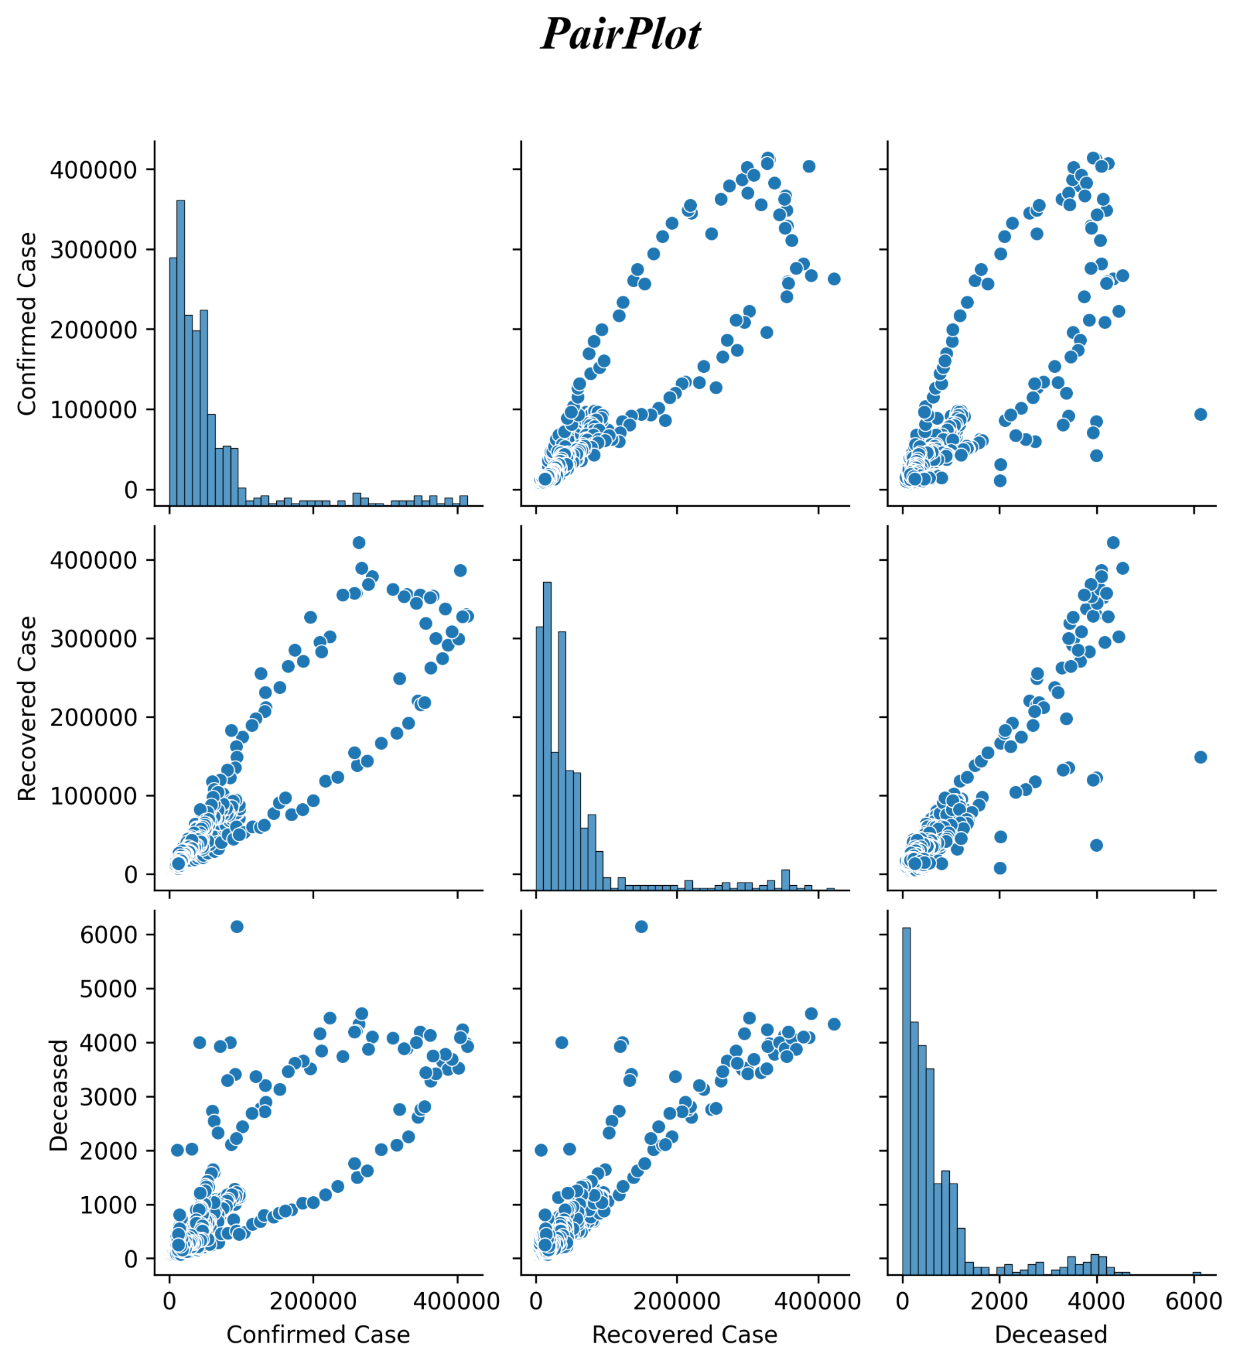
PairPlot representing the correlation between distribution of number of confirmed cases, number of recovered cases, and number of deceased cases.

Slide 23
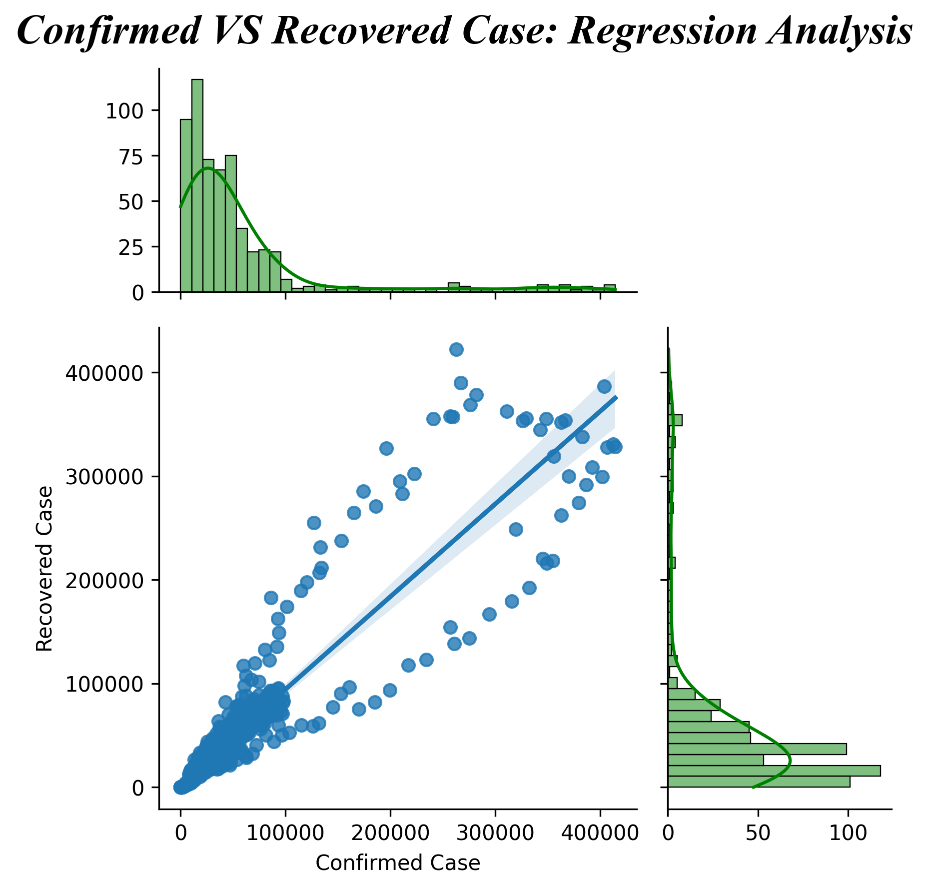
JointPlot
It is showing correlation between number of confirmed cases per day vs number of recovered cases per day. It’s showing the regression line with slope almost 1. It indicates that number of confirmed cases per day was almost equal to number of recovered cases per day.

Slide 24

Observation
There were two covid peaks in India until October 2021.
In terms of sudden spikes in the number of covid cases as well as deaths, the second covid peak was far more devastating.
The first Covid peak occurred around Sept 2020, while the second peak occurred around May 2021.
In terms of confirmed cases and recovered cases per day, they were almost equal. This is a testament to India's quality medical facilities and doctors' efforts.
The worst affected state during the corona was Maharashtra, followed by Kerala, Karnataka, Tamil Nadu, Andhra Pradesh, and Delhi.

Slide 25
Code of the project is provided in the google drive:
https://drive.google.com/drive/folders/1W4067Y--GqpbImVmDeUefADprhocvosF?usp=sharing

Slide 26
Thank You!
Prepared by:
Samir Kumar
2001CS59

